Slide 1
House Price Prediction
Exploratory Data Analysis & Modeling
By Ganesh Sura

Slide 2
Introduction
This project analyzes house listings in region wise to
Understand the factors that influence property prices.
• Dataset includes features like location, BHK, carpet area, ownership, and pricing.
• Goal: Predict house prices using exploratory analysis and regression models.

Slide 3
Problem Statements
• What factors influence house prices?
• Is there a relationship between BHK, area, and price?
• Can we predict price using floor level and location?
• Do ownership types affect the final pricing?

Slide 4
Data Preprocessing
• Dropped rows with missing values
• Removed duplicates and irrelevant fields
• Cleaned 'Amount' and 'Carpet Area' columns to extract numeric values
• Handled floor and status inconsistencies
• Encoded categorical columns (e.g., location, ownership, status)

Slide 5
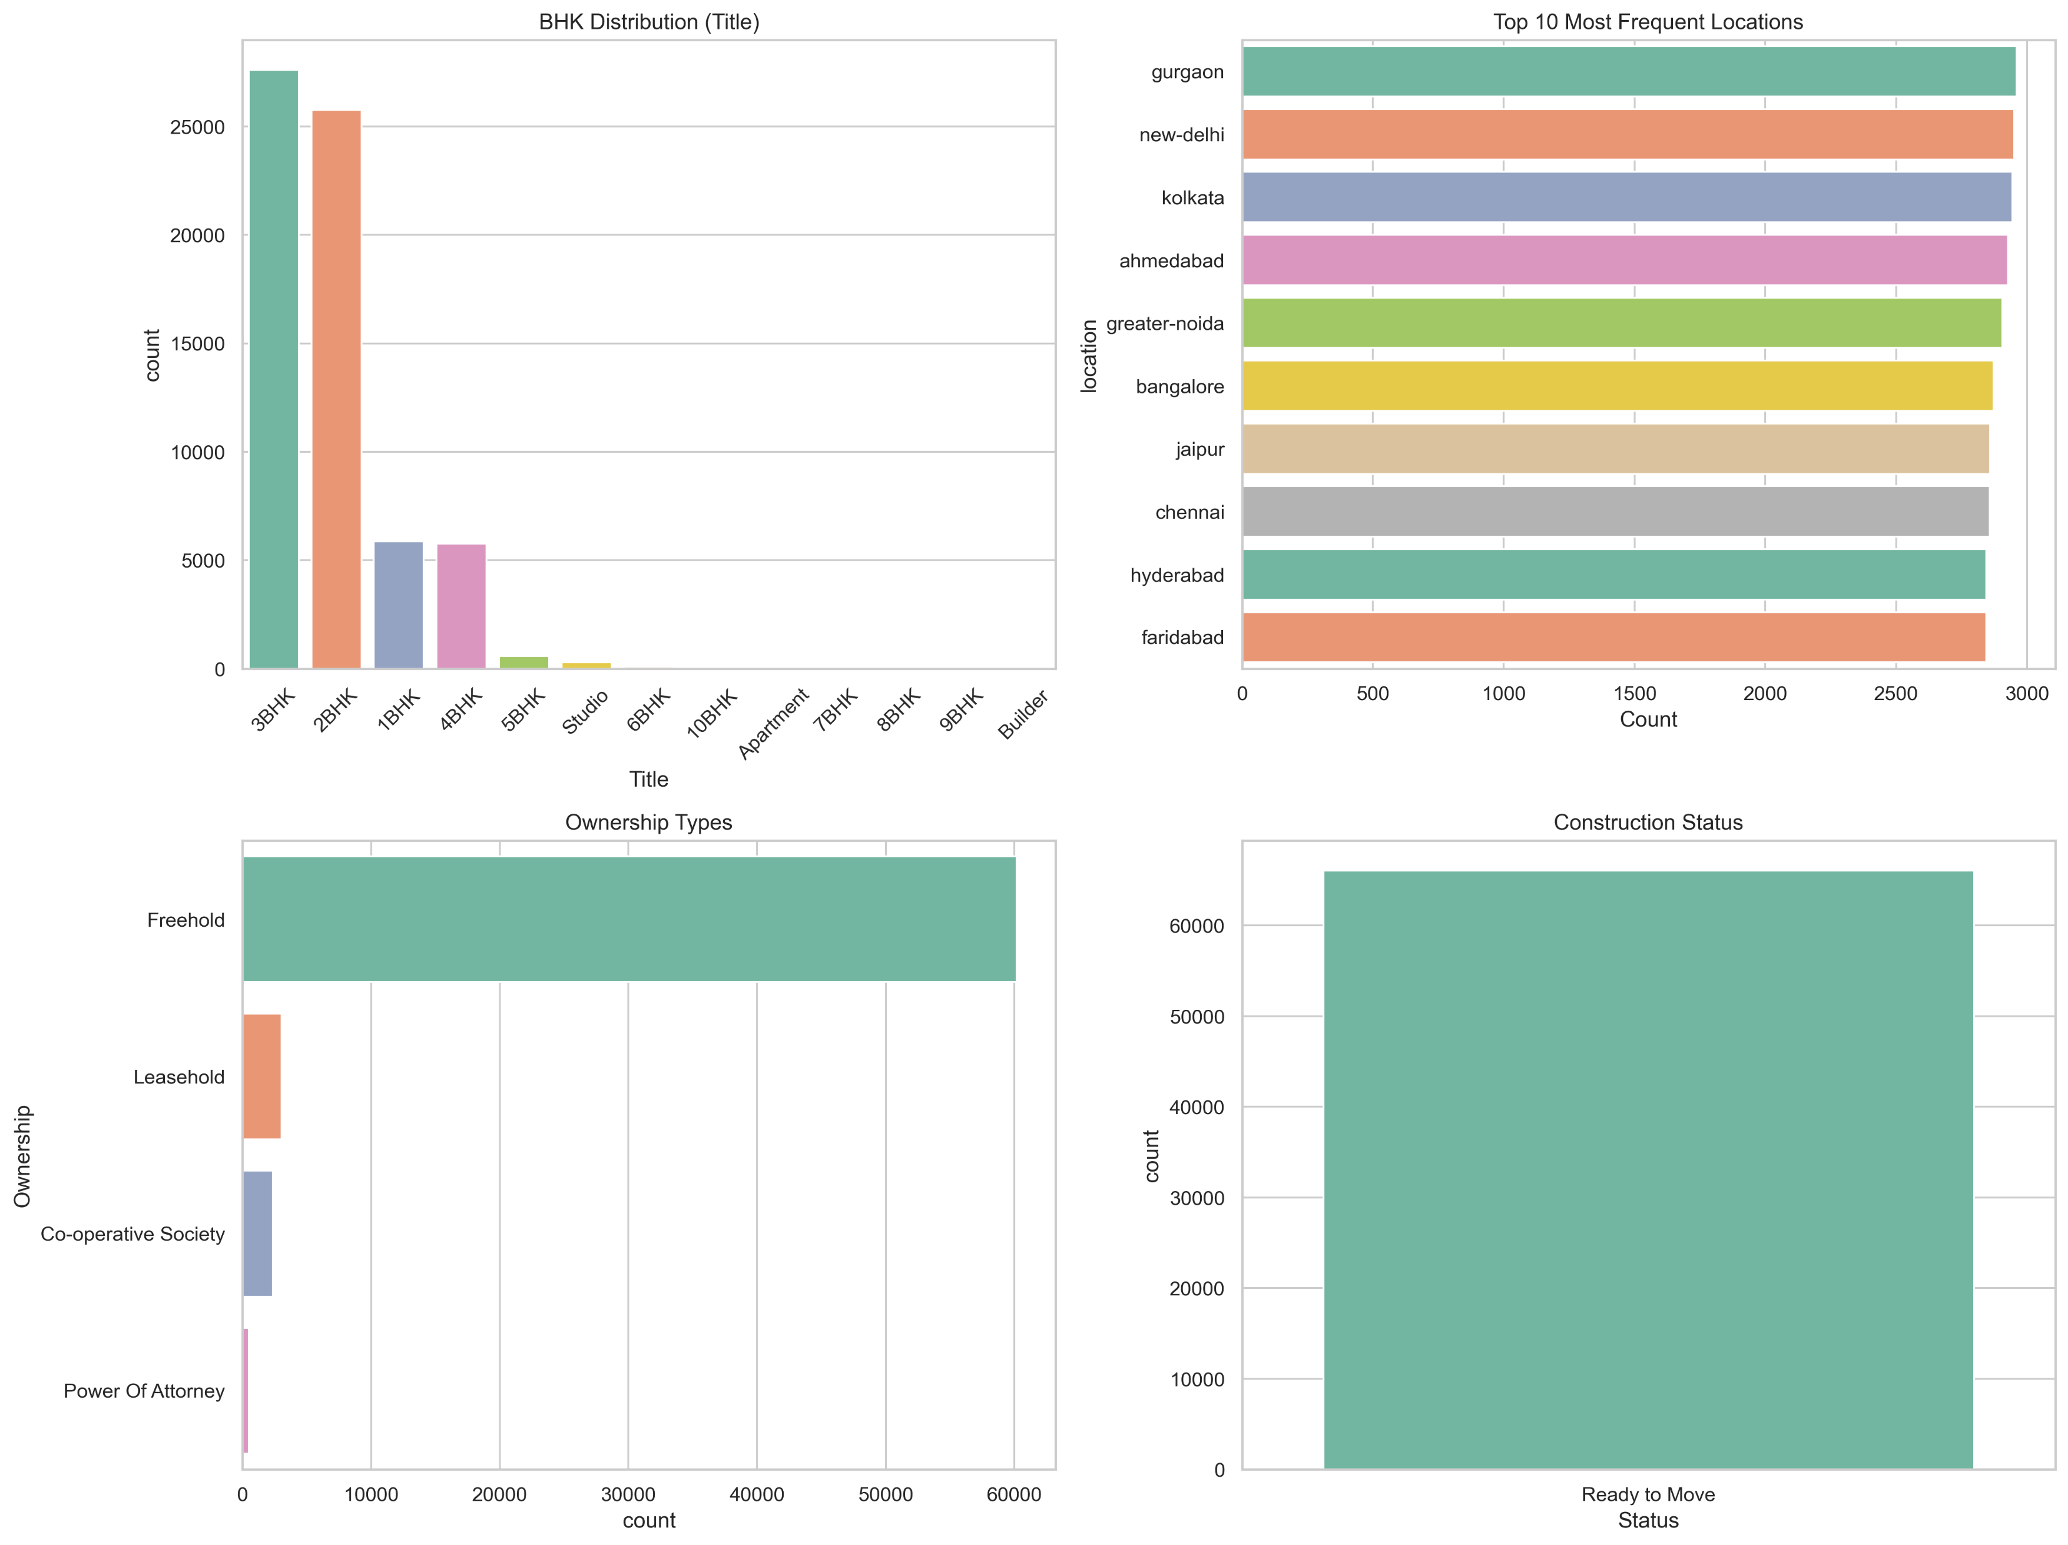
Univariate Analysis – Categorical

Slide 6
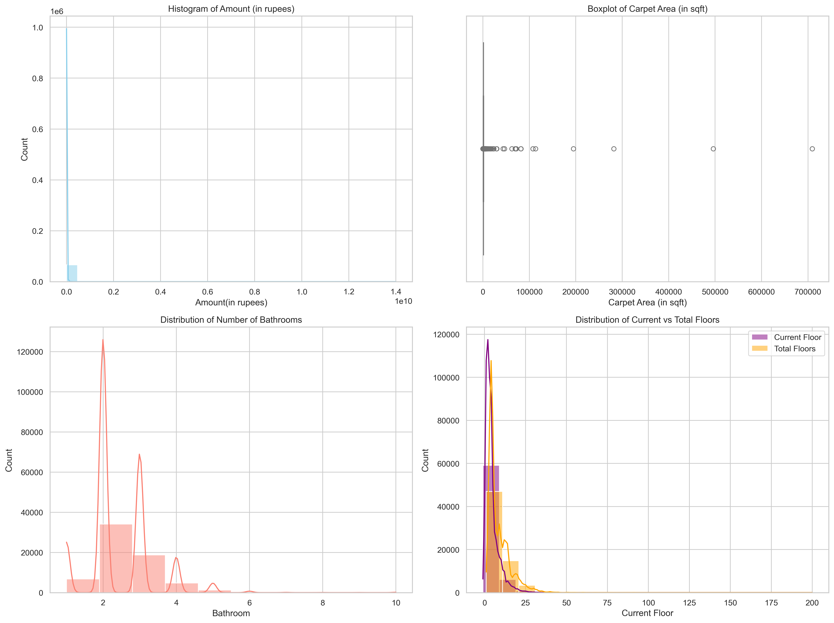
Univariate Analysis – Numerical

Slide 7
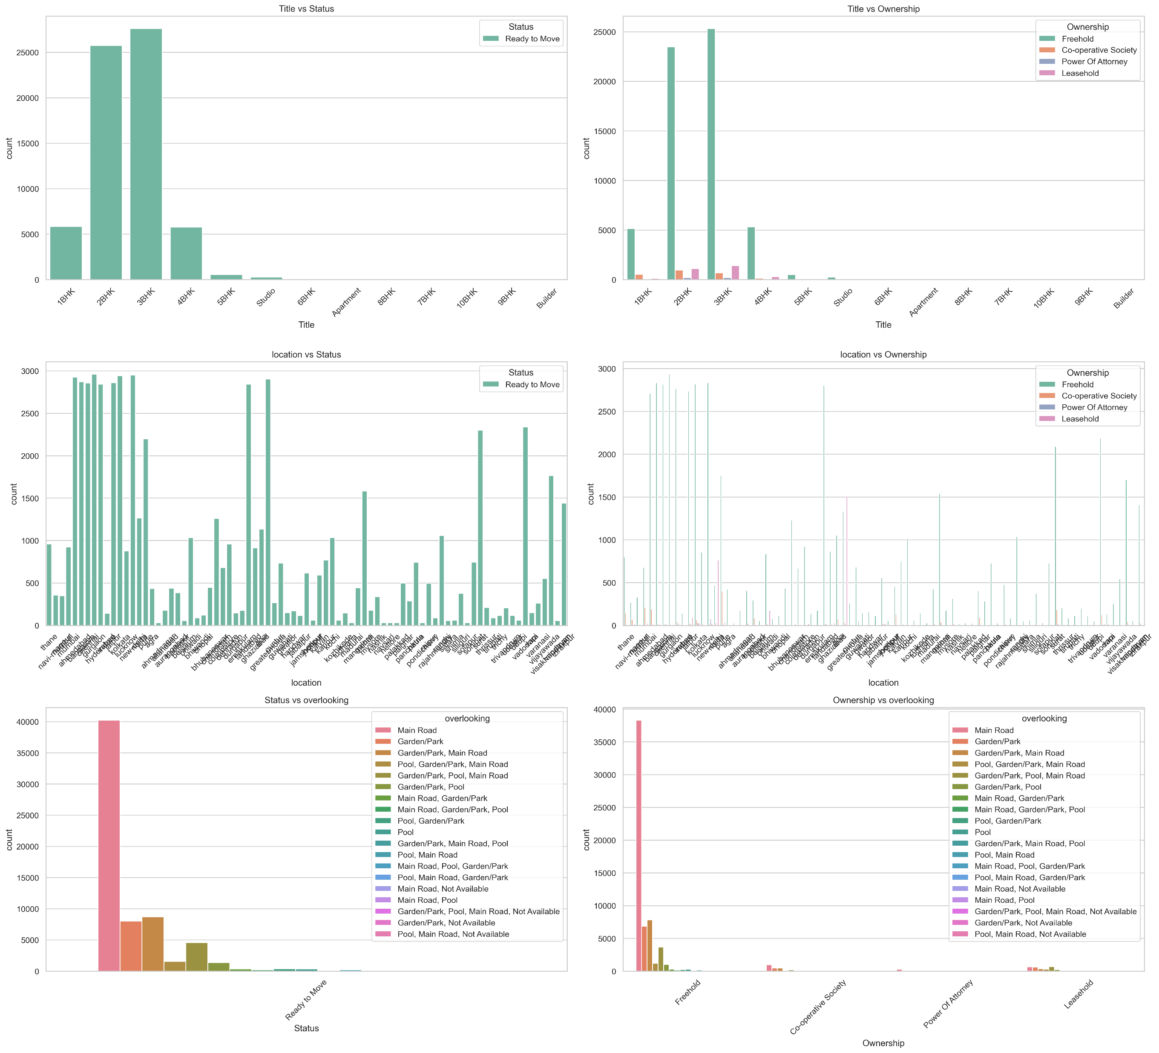
Categorical vs Categorical

Slide 8
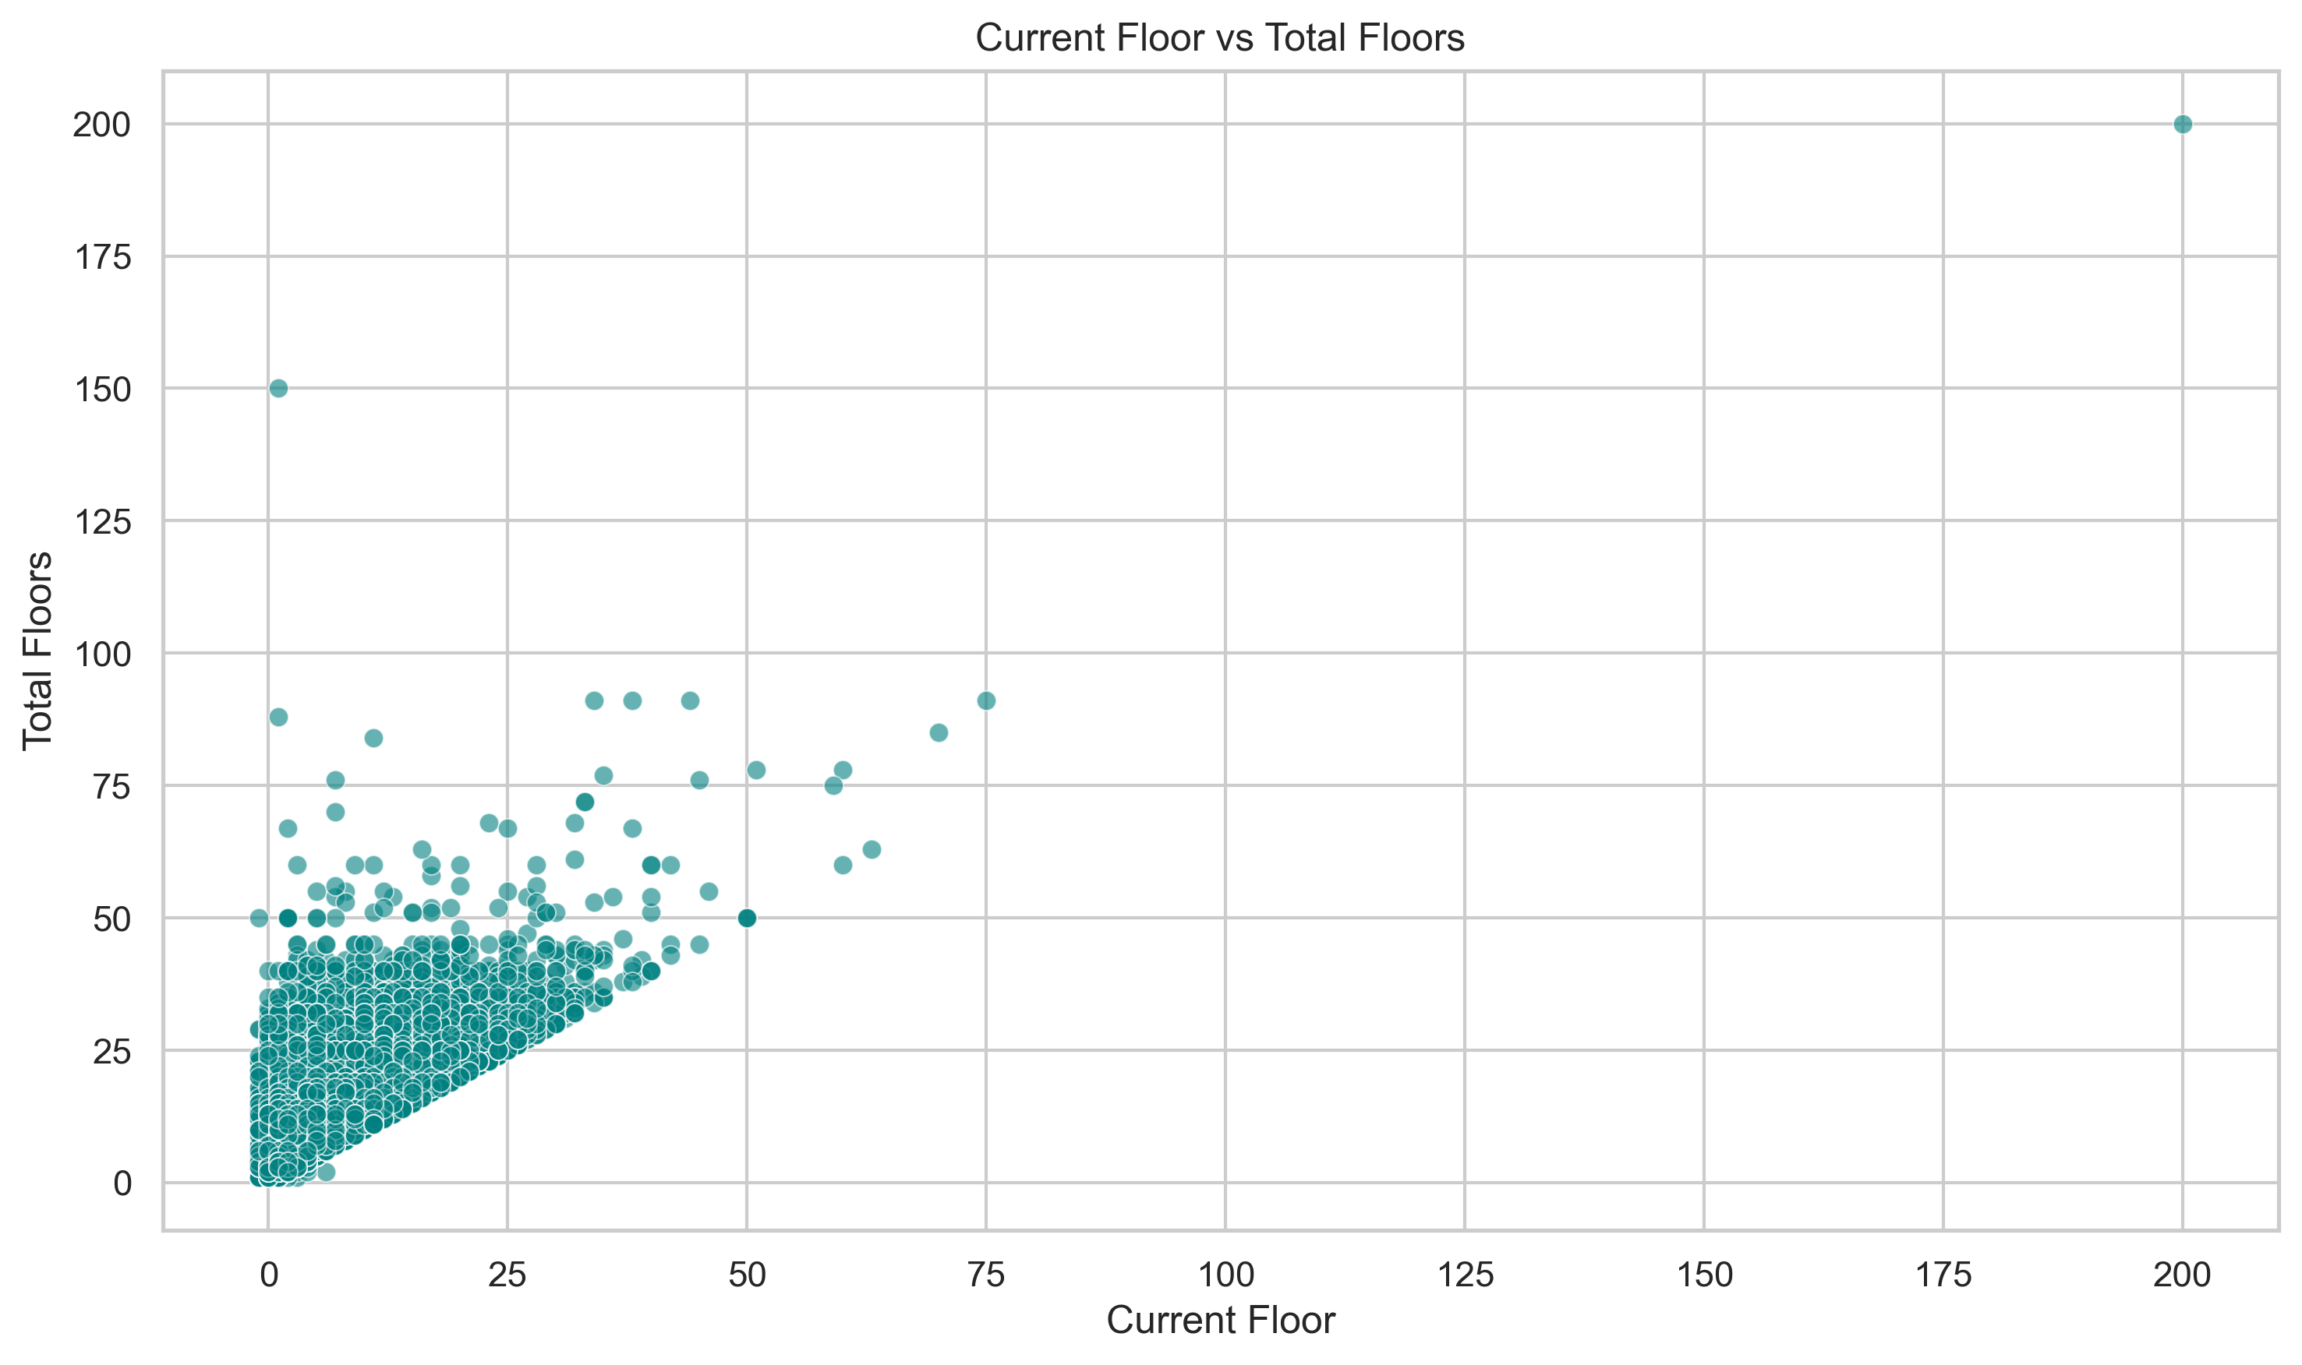
Numerical vs Numerical

Slide 9
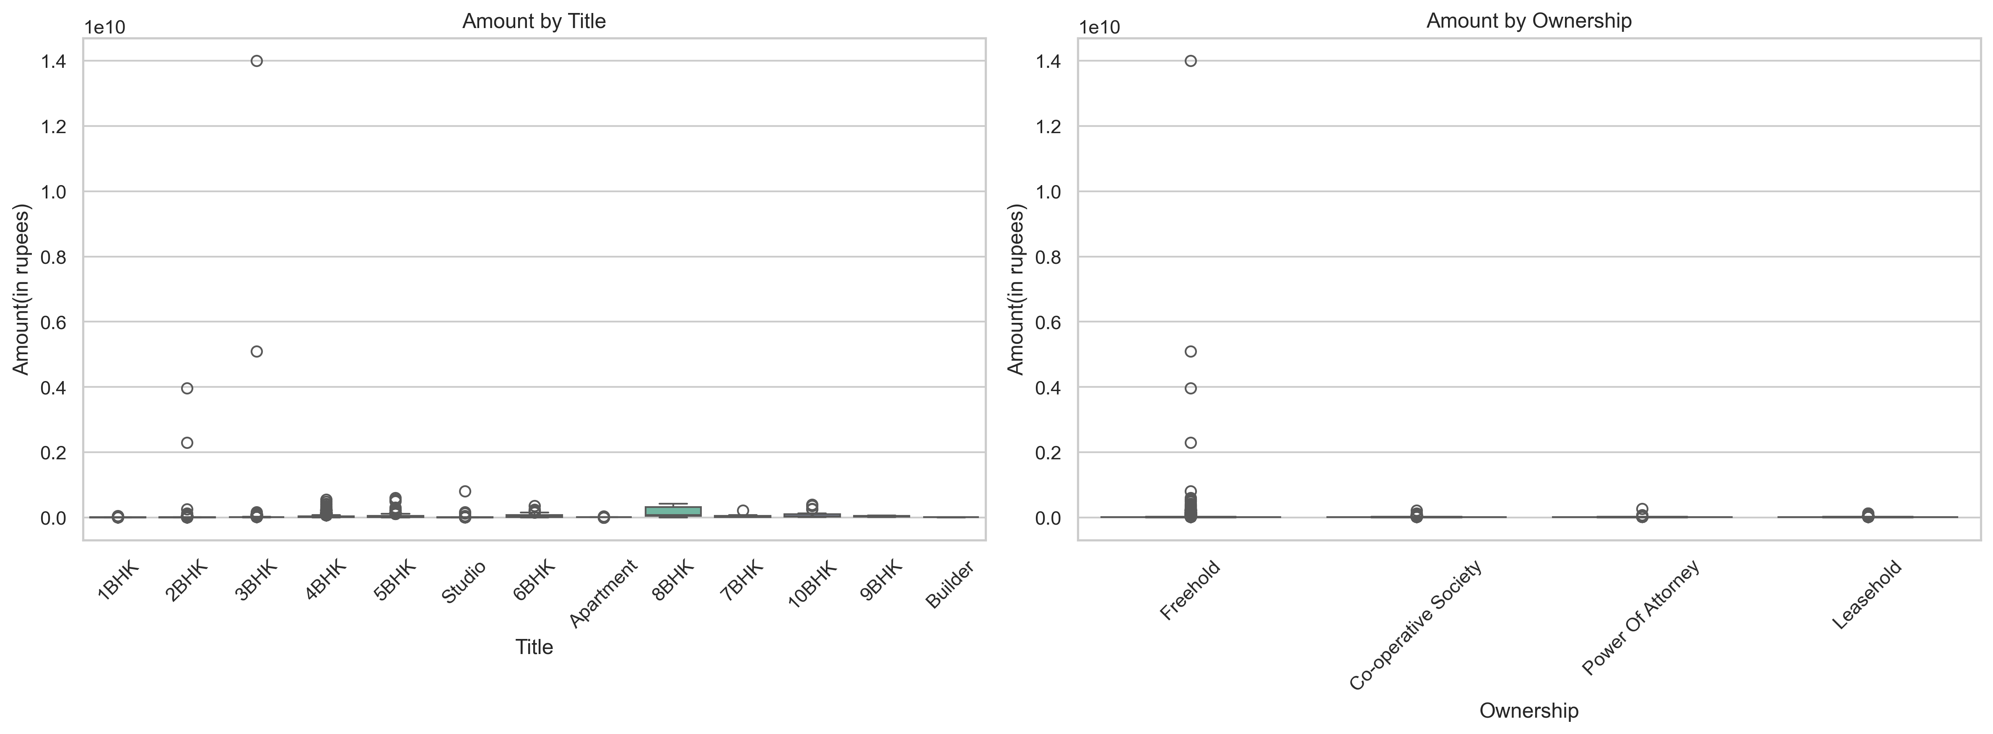
Categorical vs Numerical

Slide 10
Model Building
• Split dataset into training and testing (80/20)
• Used Linear Regression, Ridge, and Lasso models
• Normalized numeric features and encoded categoricals
• Evaluated models using RMSE and R² Score
• Visualized Actual vs Predicted price

Slide 11
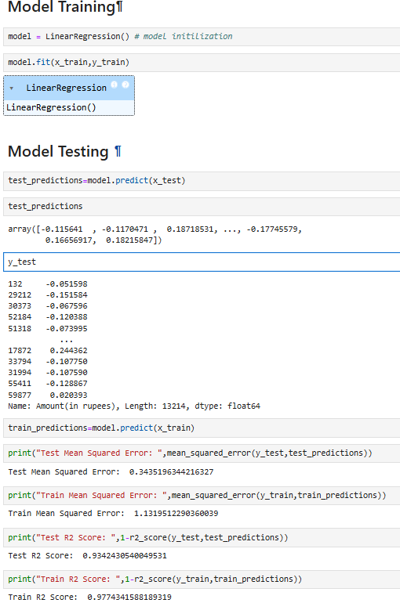
Evaluation Metrics

Slide 12
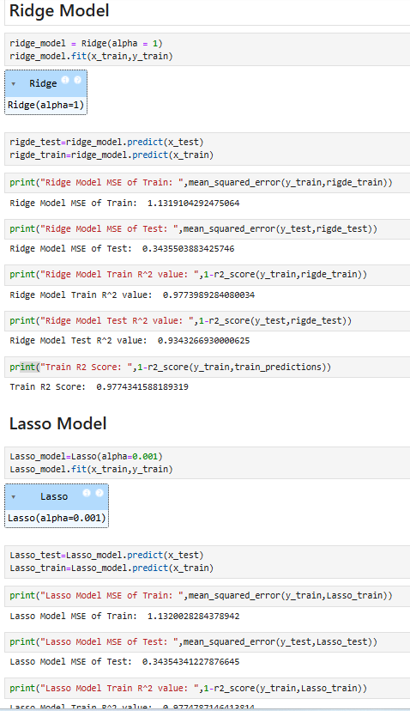

Slide 13
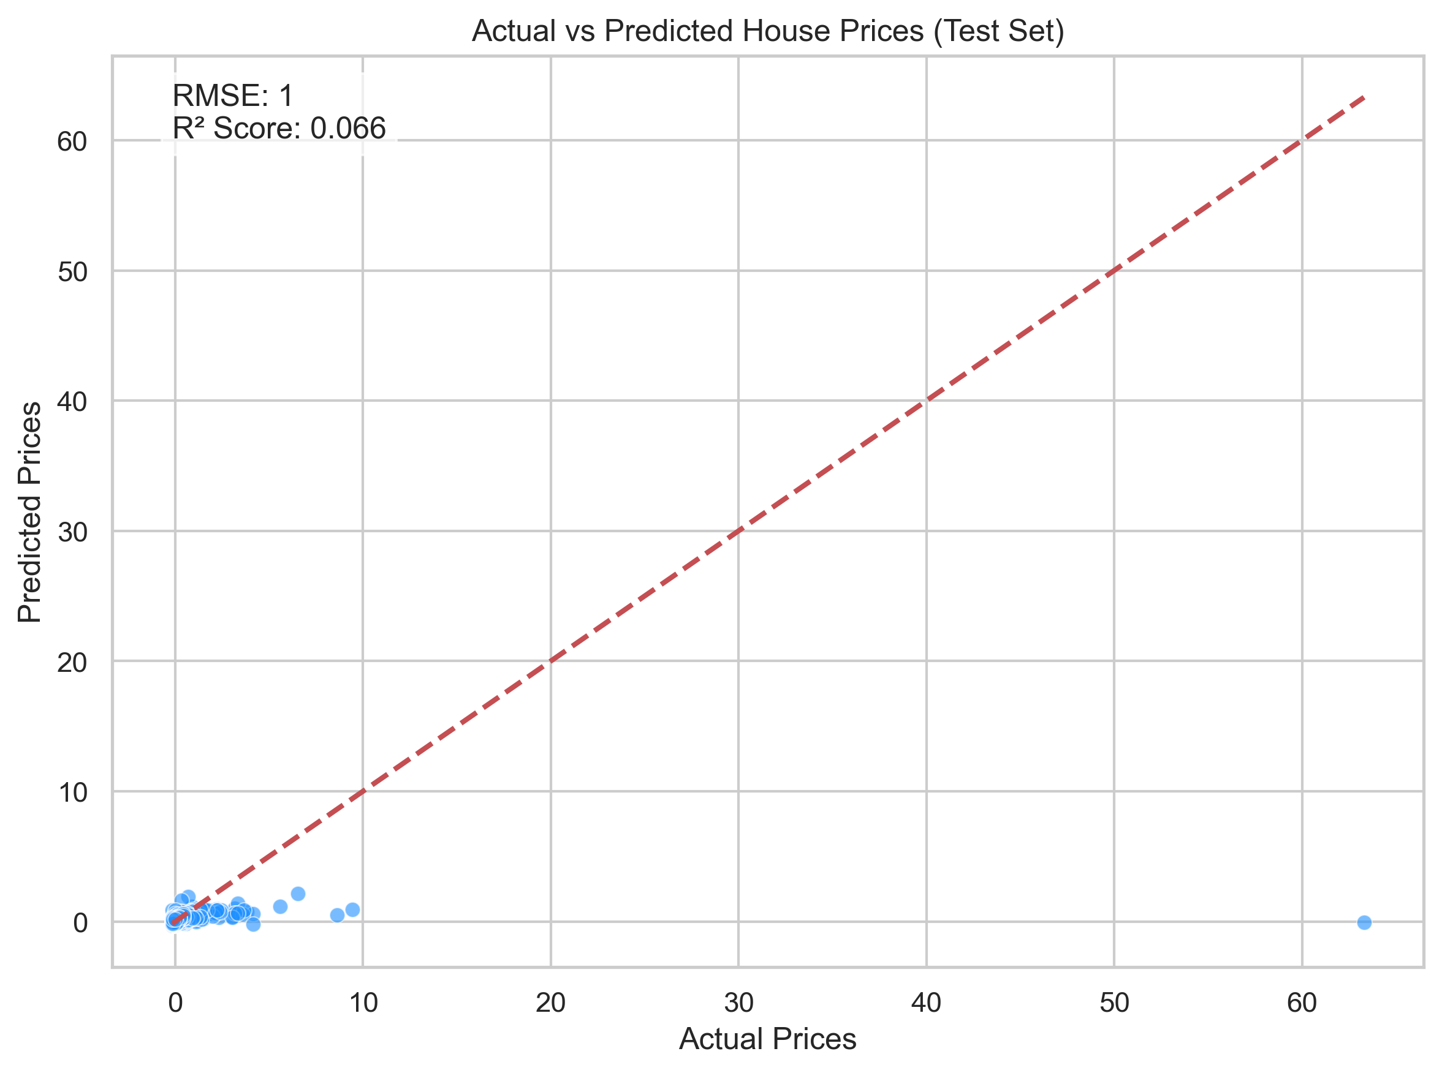
Actual vs Predicted Scatter Plot

Slide 14
Observations
• Price increases with BHK, carpet area, and floor level
• Location has a significant effect on pricing
• Ownership and Overlooking have mild influence
• Ridge regression outperformed Linear model in generalization

Slide 15
Conclusion & Recommendations
• BHK, carpet area, and location are key price influencers
• Recommend including spatial/geographic features
• Models are useful for real estate valuation and pricing decisions
• Future work: ensemble models, feature selection, map integration

Slide 16
Thank You!

